Slide 1

UC: Agriculture and Biodiversity Nexus
FAIRiCUBE technical kick-off meeting, Vienna, 13 – 14 October 2022
Rob Knapen & Marian Vittek
Wageningen Environmental Research

Slide 2
Background on the Use Case: What problem does it aim to solve?
Biodiversity in agricultural areas in Netherlands declines due to several factors such as land intensification and reparcelling
Biodiversity and agriculture are interlinked, share benefits and are susceptible to changes
It was proven that various agricultural activities have different impact on the environment and on biodiversity, however:
The correlations are poorly understood, likely complex, and difficult to clarify;
Needed data for research is difficult to obtain, heterogeneous, imprecise, restricted, and not representative due to its size;
Current studies are mainly local in scope, inconsistent and difficult to compare at different scales.
This Agriculture – Biodiversity Nexus use case aims to:
Help to explain links between biodiversity and agriculture by detecting patterns in the data through the use of machine learning;
Provide a step forward in making more precise estimates of biodiversity in spatial context;
Improve the data challenges by the use and sharing of prepared data cubes;
Add to the current knowledge base by cooperating with domain experts;
Ultimately assisting stakeholders in selecting more nature-inclusive practices promoting biodiversity.
Notes:
Aim: Please describe the background of the Use Case: what is the underlying problem that it aims to tackle?
There is an expected influence of the way a farm and its land is managed on the surrounding biodiversity. However, these relations have shown to be complex and hard to substantiate. Yet there is a desire to reward farmers for using more nature-inclusive methods. This use case aims to address this gap by detecting possible patterns in relevant agriculture, biodiversity, and environmental data, using data driven approaches based on machine learning techniques and data cubes; and validating results with agriculture and biodiversity experts and stakeholders.
Diversity in genes, species and ecosystems is essential for the survival of food crops.
Mutual benefit of biodiversity and agriculture - in providing habitat for fauna and flora and facilitates optimum prodictivity
Agricultural activities has impact on biodiversity

Slide 3
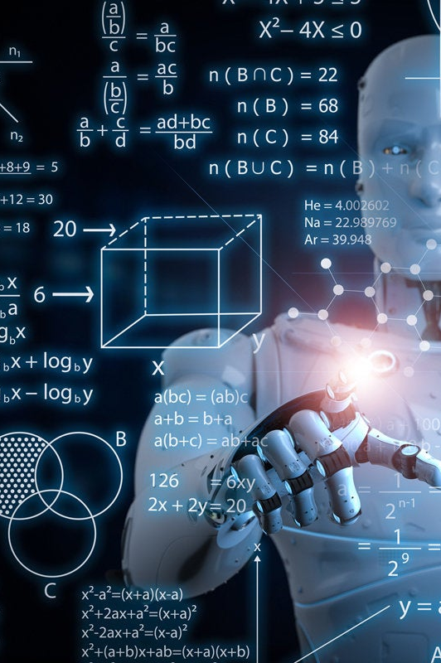
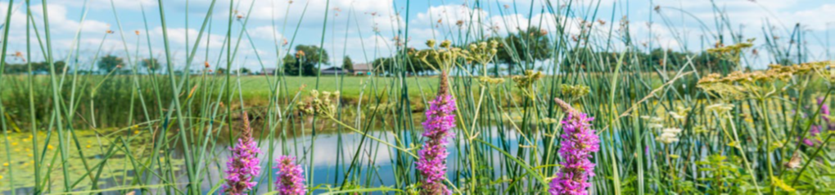
What is the Use Case about?
For a sample study region, we will acquire relevant datasets on agricultural land management, species occurrences (e.g. for selected bird species, herb rich grasslands), remote sensing data, derived indicators of agricultural activities and environmental data.
When the data is loaded in data cubes, based on data characteristics and availability we will iteratively perform various machine learning experiments using features (and labels) selected from the data cubes, and create (ensembles) of AI models and processing pipelines that give the best possible results.
When needed, methods for data gap filling and enhancement will be developed and applied.
The models and processing pipelines will be shared and used in web clients that stakeholders can access.
All steps above will be iterated to adjust for learned insights, feedback from stakeholders, availability of new data, additional regions and national extent.
Notes:
Aim: Please describe how the Use Case is planning to solve the problem described

Slide 4
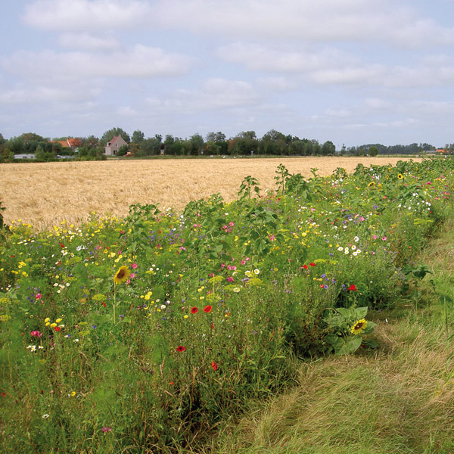
What are the expected results?
Improved knowledge about the relations between different agricultural practices and biodiversity
Using new innovative data oriented approach which is consistent at large scales
F.A.I.R. Analysis Ready datasets for re-use by stakeholders
Preferably open, but restricted when needed
Trustworthy AI models, and data processing pipelines
Shared via FAIRiCUBE hub, GitHub, and other channels
Deployed concept applications (web clients on EOx) for stakeholders to use
Increased awareness about data cubes and AI by domain stakeholders
Both on the smart agriculture and biodiversity side
Notes:
Aim: Please describe the expected results of the Use Case

Slide 5
Which stakeholders will benefit from your results?
Stakeholder type | Benefit from UC | Other remarks
(ML/EO) Data Engineers | Data Cubes, tech, infra | Direct stakeholders
(ML/EO) Data Scientists | Data Cubes, ML, infra | Direct stakeholders
Domain researchers | Findings, content, data | Direct stakeholders
Farmers, cooperatives | Insights, financial - subsidies | Indirect stakeholders
Policy makers | Insights, research results | Indirect stakeholders
General public | Insights, environment | Indirect stakeholders
Governmental institutions | Findings, content, data | Indirect stakeholders
Notes:
Aim: Please describe the type of stakeholders that will benefit from the Use Case (policy makers, general public, knowledge institutes, IT companies, etc...)

Slide 6
How are you expecting to disseminate these results?
Expected result | Dissemination type | Other remarks
Datasets | (Data) Publication | Open if possible
Research (EO, ML, domain) | Publication, presentation | Journal / Conference
Web clients (applications) | Online, webinar, posts | Hosted by EOX
Technology, ML | Online, posts, hackathon | Demo Notebooks
Models and processing pipelines | Online repositories | On FAIRiCUBE GitHub
Training for direct stakeholders | Training | Using web applications
Info for indirect stakeholders | Demonstrations | Using web applications
Notes:
Aim: Please elaborate how you are planning to disseminate the Use Case results. These include for instance: deliverables, policy briefs, videos, podcasts, webinars, visuals, etc..

Slide 7

Other information to share?
Agriculture – Biodiversity Dashboard mockup
Data processing workflows
Some data samples
Initial Machine Learning ideas

Slide 8
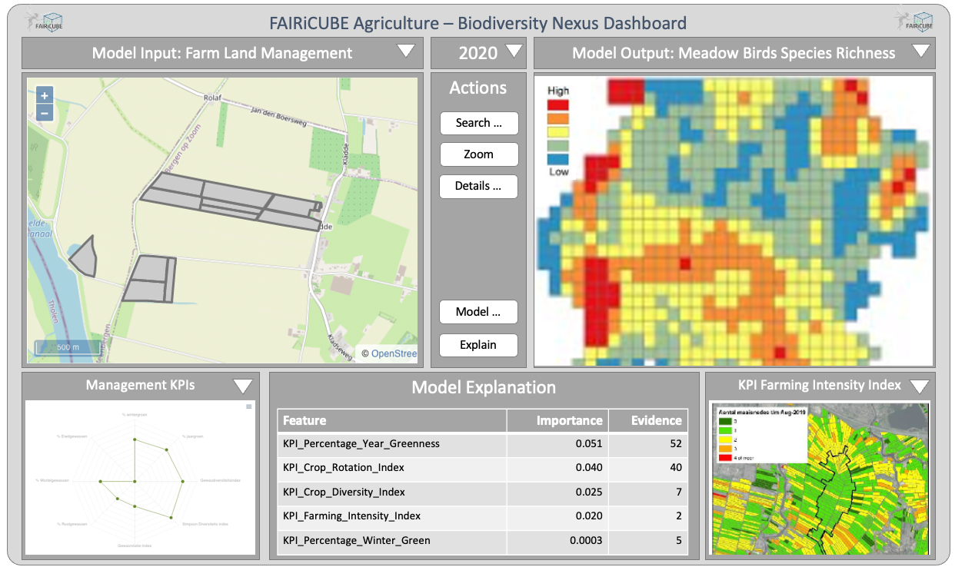
Draft Web Client – Dashboard Mockup

Slide 9
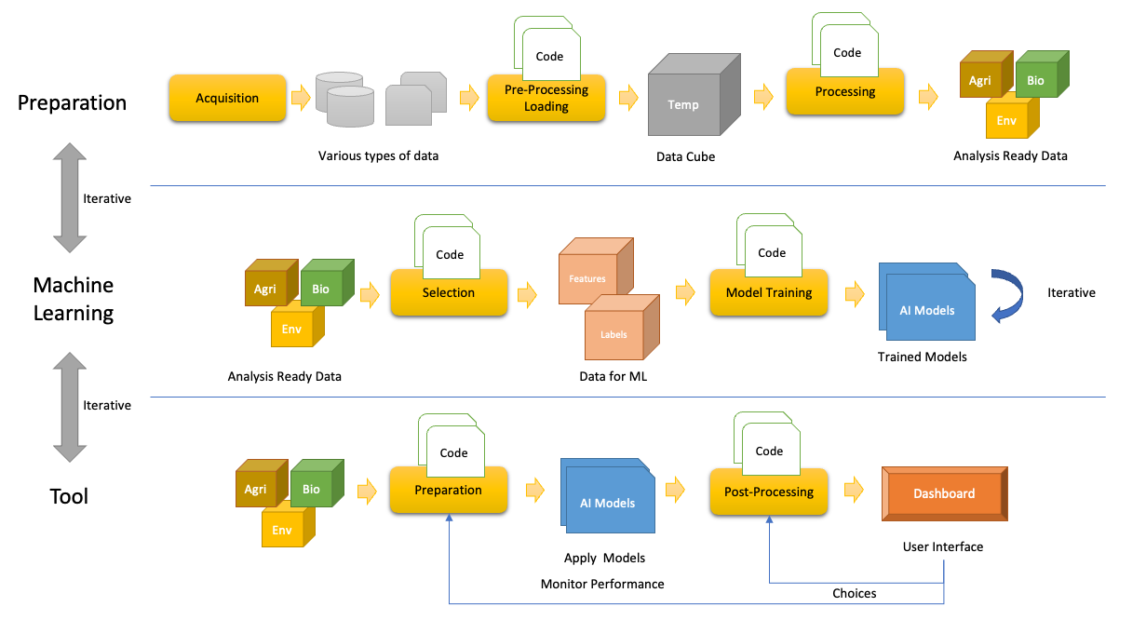
How could the Use Case workflows look?

Slide 10
Data / Expertise Inventory
Environmental data
Remote sensing (e.g. Sentinel 1 + 2)
Remote sensing derived signals, markers and indices – e.g. NDVI
Land use/cover - LULUCF, LGN, CORINE
Weather, terrain, soil, etc.
Agricultural data
Crop parcel registration -BRP (vector) – crop rotation
Agricultural nature management (ANB) – subsided measures in agricultural land taken in favor of nature
Remote sensing derived KPIs – percentage of permanent grassland, number of mowing events, biomass, production,...
Agrodatacube – available at WENR with free access (per parcel data)
Farm management activities (tabular, restricted)
Farmer data (difficult to obtain, restricted, requires case-by-case consent at the moment)
Biodiversity data
Existing remote sensing derived products (some EBV, HR-VPP, etc.)
Species ((meadow) birds, butterflies,...)
Statistical data (per country, provinces, usually estimations)
Large scale species occurrence data - GBIF
More detailed, In-Situ observations - NDFF (difficult to obtain, restricted, imprecise)
Need to work with data owners / researchers case-by-case
Literature and expert knowledge on farm management – biodiversity relations
Acquisition
Various types of data

Slide 11
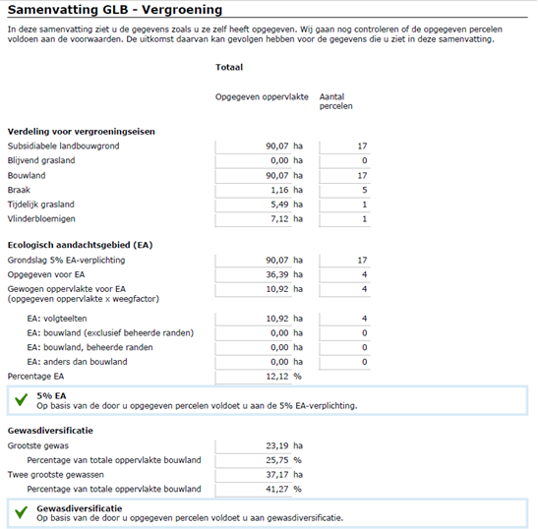
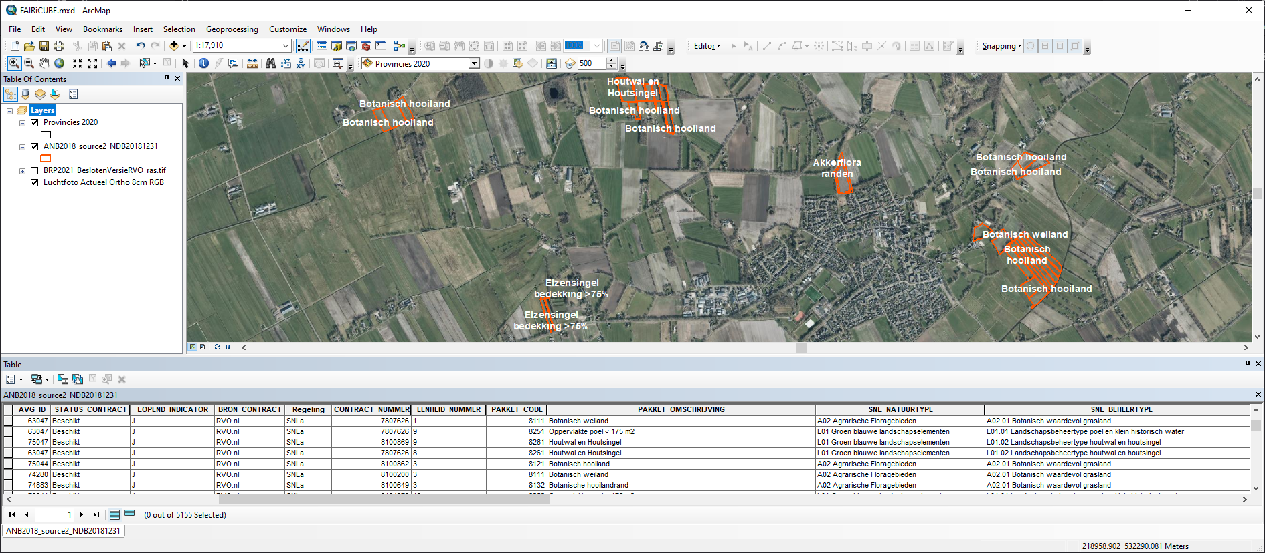
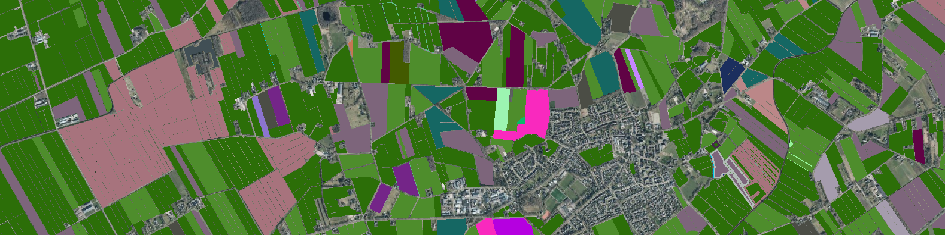
Data Samples: Agriculture

Slide 12
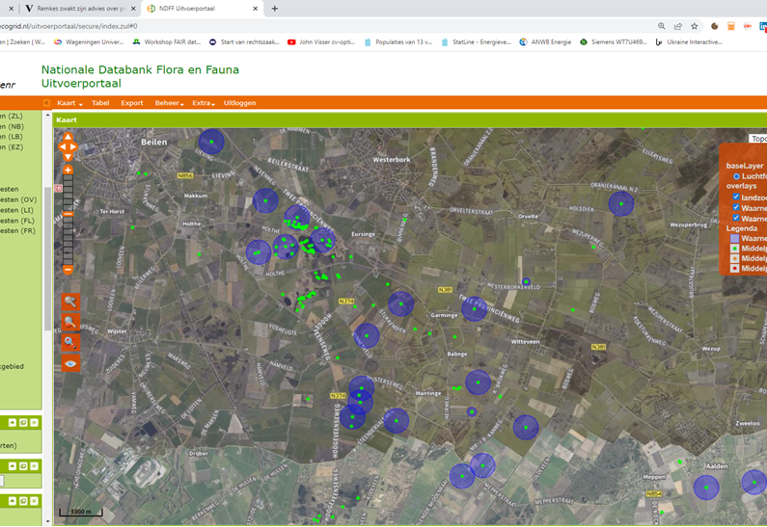
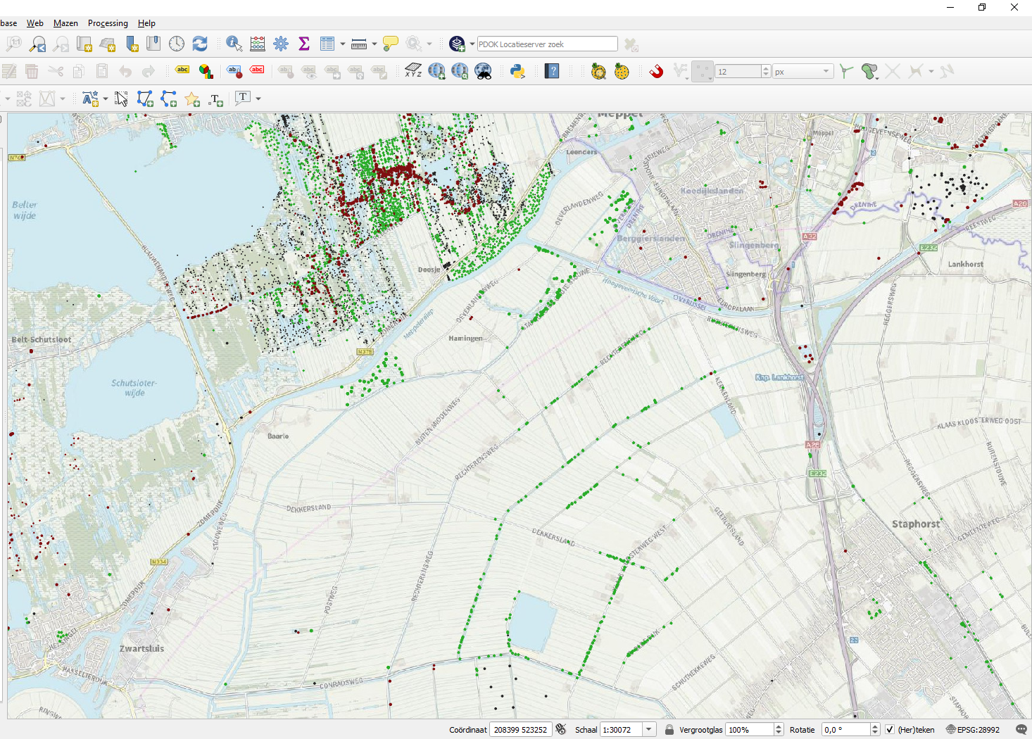
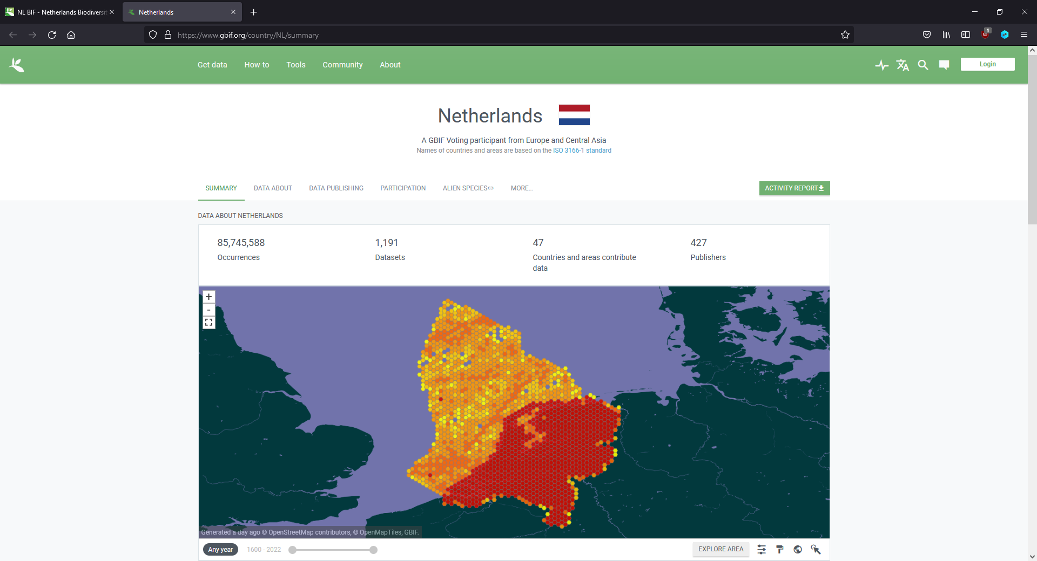
Data Samples: Biodiversity

Slide 13
Use Case Machine Learning Options
Feature Data
Gridded, but can be:
Timeseries
Sparse/Imprecise (in-situ)
Aggregated
Interpolated
Can be restricted data
Can be biased
Label Data
Similar to feature data
Might need to be generated
Unsupervised learning
Weakly supervised learning
Synthesized
Can be restricted data
Can be biased
Model Training Results
Needs to be:
Explainable
Trustworthy
Predicts Biodiversity ‘Indicators’
EBV
Probability
Suitability
Species Index
Abundance
Diversity
Will be compute intensive
Hyperparameter tuning
Will be exploratory and iterative
Experiment management
Notebook
Features
Code
Model Training
AI Models
AI Models
Labels
Trained Models
Model Training
Depends on input data type and kind of inference:
‘Shallow’ Learning: RF, CatBoost, SVM
Deep Learning: MLP, CNN, LSTM, Transformers
Ensemble Learning: Mixed models + classifier
Needs to address sparse and biased data
Needs to deal with spatial and temporal impreciseness
Needs to handle restricted data

Slide 14

Other information to share?
Initial ML Framing of the use case
Probably classification, regression, (maybe for recommendation)
Has to work on data cube (gridded) data
Start simple with heuristics from current research
On Farm KPIs, land use , herb rich grasslands, (meadow) birds
(re)produce a baseline
Might have to start with tangential or weakly labelled data
Estimate best possible results for AI models given such data
Create first product quickly to get feedback (and better data?)
Could be an integration with FarmDS – KPI-K Dashboard
Add the FAIRiCUBE project as option to FarmDS consent form
Get anonymised crop parcel ownership and KPI data
Iterate on data and modelling to improve results
Measure (deployed) product performance
user feedback mechanism
What users view / click at in the dashboard might be relevant data for ML refinement

Slide 15
Discussion
Are there any guidelines which we can use to identify that input data are FAIR and can be used in project?
Who (which WP) is responsible for work on which part of workflow?
What information has to be included in the next deliverable document?
Could we use a live document which is at certain point(s) saved as deliverable?
Will be presentations showed online on the project website?
Modifications in approach comparing to proposal:
Not an assessment on farm level – privacy – data can’t be tracked to farm as unit
Assessment will be done on regional level
Not using KPI data from farmers

Slide 16
Thank you for attention!

